Slide 1
hypothes.is

Slide 2
All knowledge, annotated.

Slide 3
1013
Notes:
So, there are perhaps a few helpful ways to illustrate this project. One is to think back 1000 years. Most of the conversations , and realize how we’re really missing most of what’s happened around the documents, events, and advancements

Slide 4
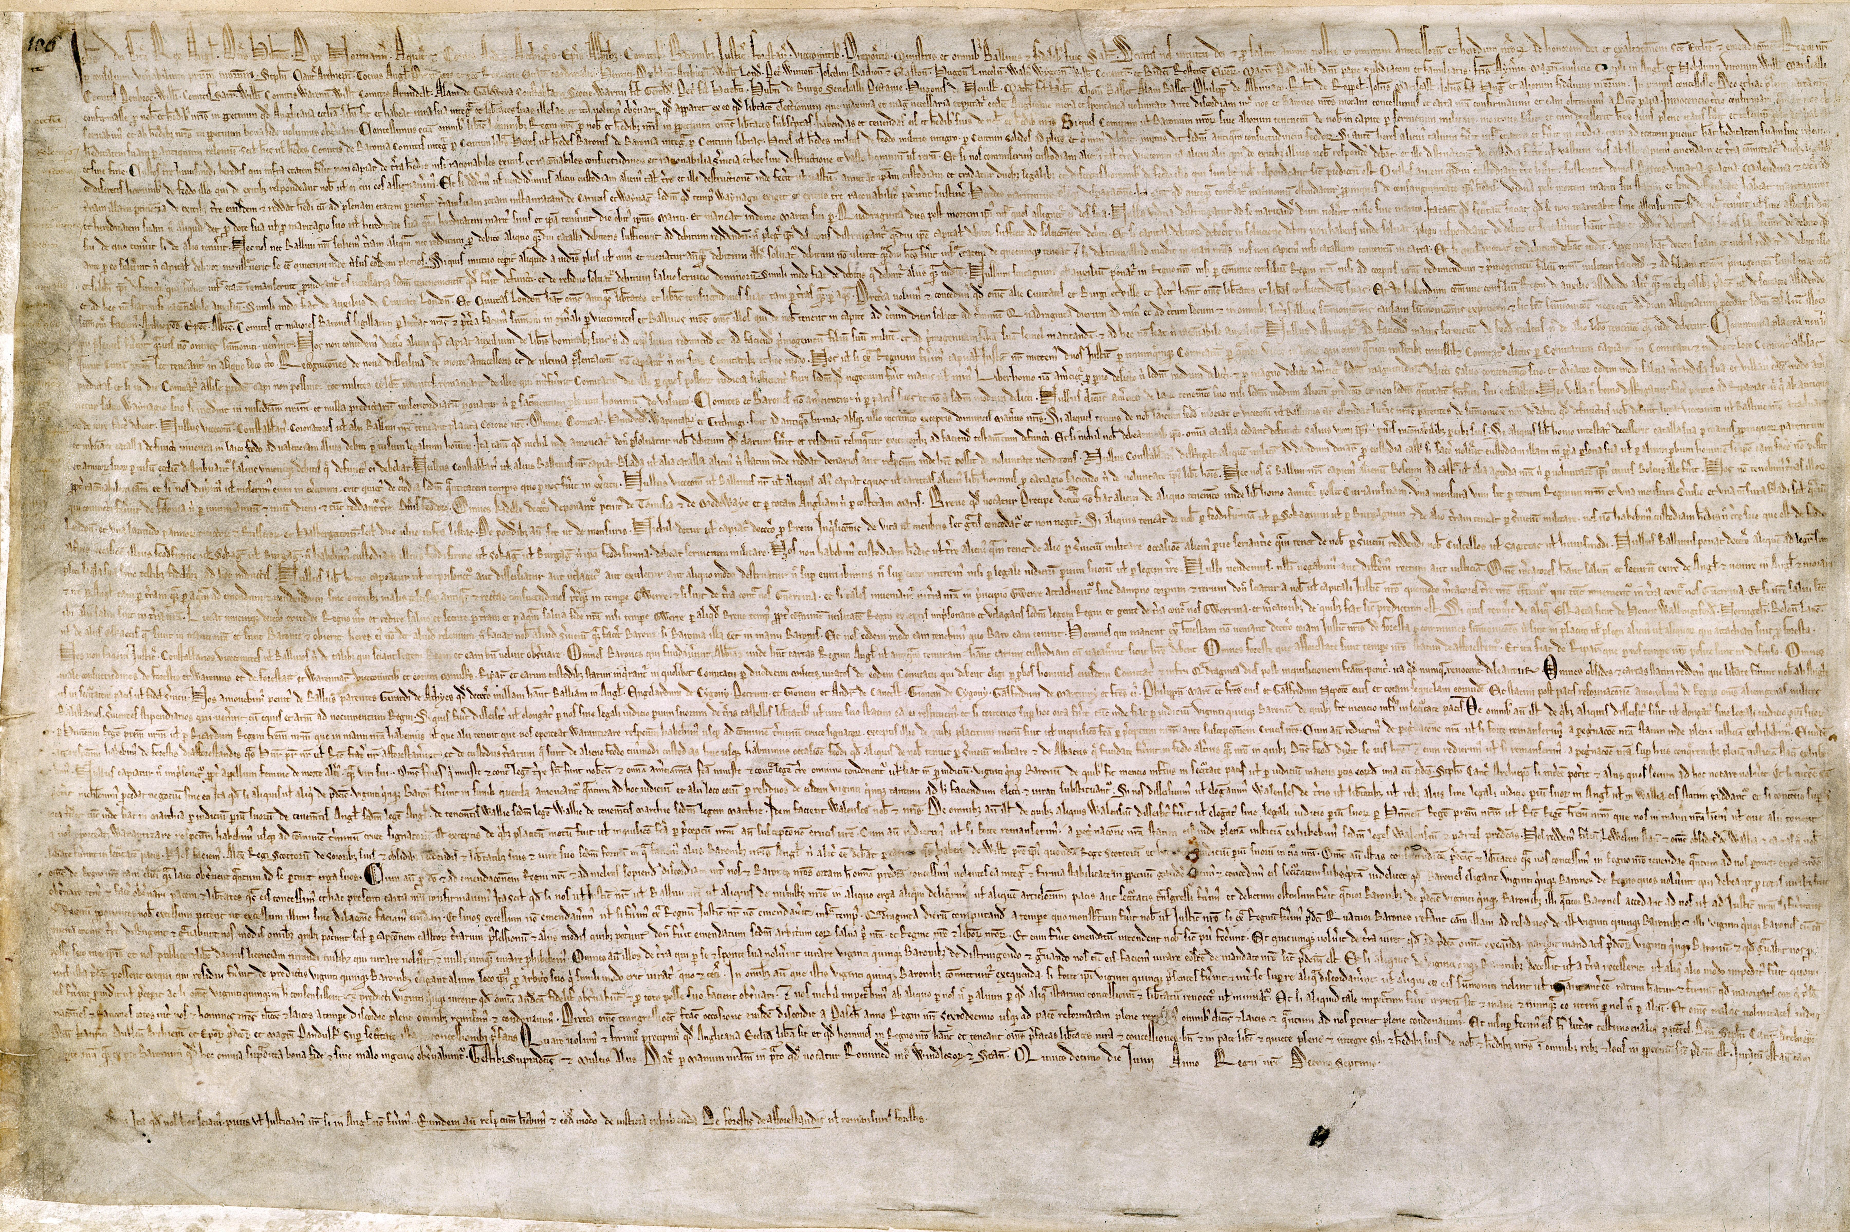
Notes:
Magna Carta in 1215.

Slide 5
2013
Notes:
There’s no shortage of things to annotate.
Laws
Scientific articles
Tweets
News
Wikipedia
Journal articles
Books
Data

Slide 6
2023
Notes:
As we move forward. How do we ensure that

Slide 7
3013
Notes:
Time is really one of the most powerful design constraints around this problem.

Slide 8
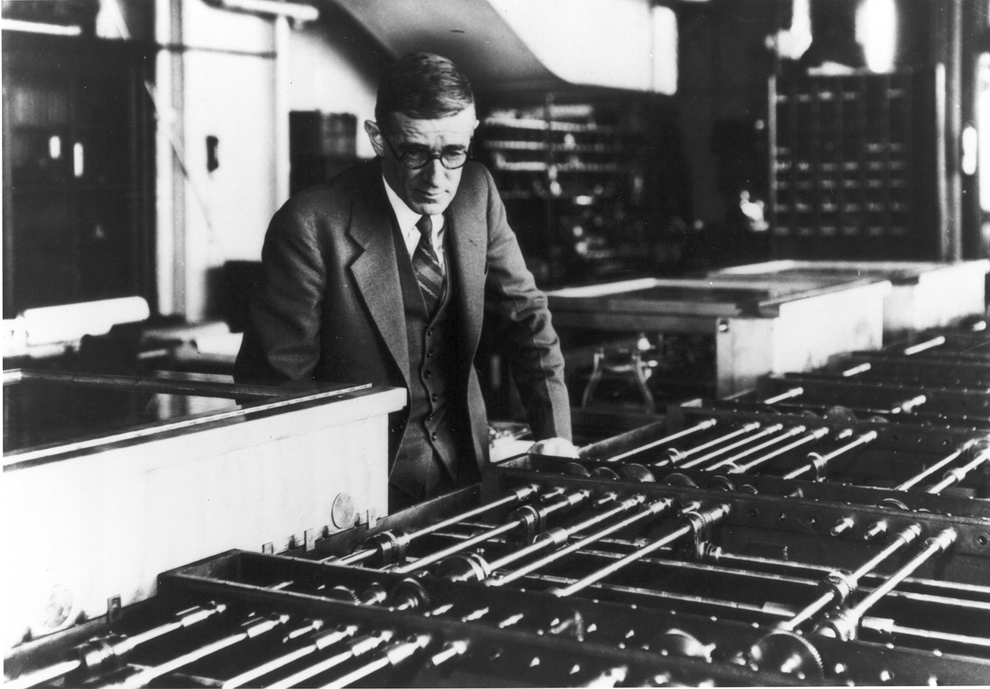
Notes:
It was perhaps VanNEEvar Bush that first had this dream--

Slide 9
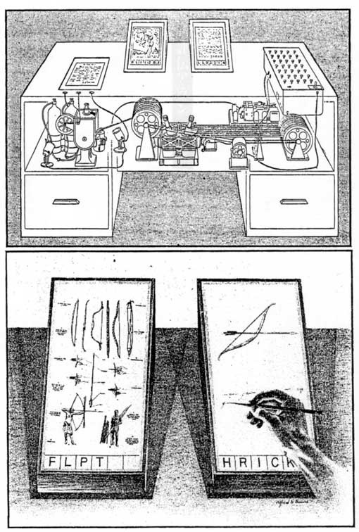
Notes:
Wholly new forms of encyclopedias will appear, ready made with a mesh of associative trails running through them, ready to be dropped into the memex and there amplified. The lawyer has at his touch the associated opinions and decisions of his whole experience, and of the experience of friends and authorities. The patent attorney has on call the millions of issued patents, with familiar trails to every point of his client's interest. The physician, puzzled by a patient's reactions, strikes the trail established in studying an earlier similar case, and runs rapidly through analogous case histories, with side references to the classics for the pertinent anatomy and histology. The chemist, struggling with the synthesis of an organic compound, has all the chemical literature before him in his laboratory, with trails following the analogies of compounds, and side trails to their physical and chemical behavior.
The historian, with a vast chronological account of a people, parallels it with a skip trail which stops only on the salient items, and can follow at any time contemporary trails which lead him all over civilization at a particular epoch.
There is a new profession of trail blazers, those who find delight in the task of establishing useful trails through the enormous mass of the common record.

Slide 10
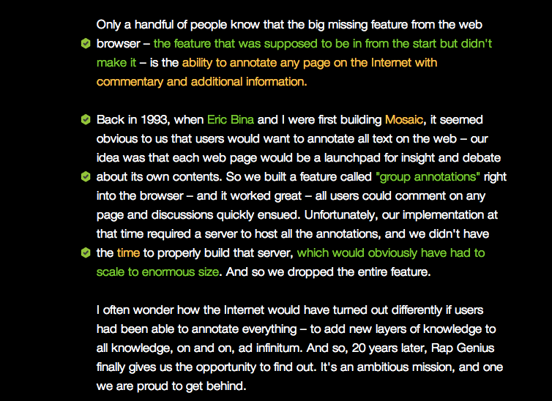
http://rapgenius.com/Marc-andreessen-why-andreessen-horowitz-is-investing-in-rap-genius-lyrics
Notes:
http://rapgenius.com/Marc-andreessen-why-andreessen-horowitz-is-investing-in-rap-genius-lyrics#lyric
[READ]
So the question is… how do we get this back into the browser.
D

Slide 11
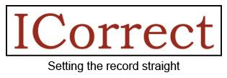
hypothes.is/historicalprojects
Notes:
What I didn’t know at the time was how many people had had the same idea.

Slide 12
Why we don’t have this.
No peer-review model.
Not annotation based.
No way to link inside things.
No cold start strategy.
Not open, not interoperable.
Poor design.
Short term thinking.

Slide 13
A non-profit project to enable community moderated annotation of the world’s knowledge.

Slide 14
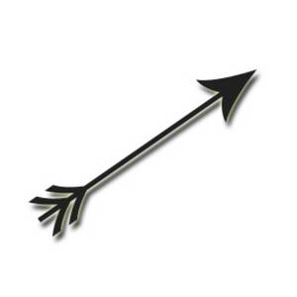
An annotation
address
payload
target
Notes:
An annotation is like an arrow with a payload

Slide 15
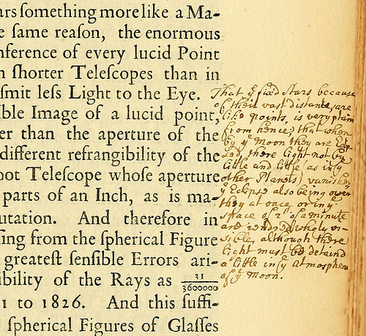
Notes:
Here’s one by Isaac Newton.

Slide 16
target
(specific location)
payload
Notes:
The target is a place inside a book. Here, a treatise on optics.
The content is what was scribbled there.
The author, of these scribbles, in this case: Sir Isaac Newton.

Slide 17
Digital annotations are addressable
http://domain/path

Slide 18
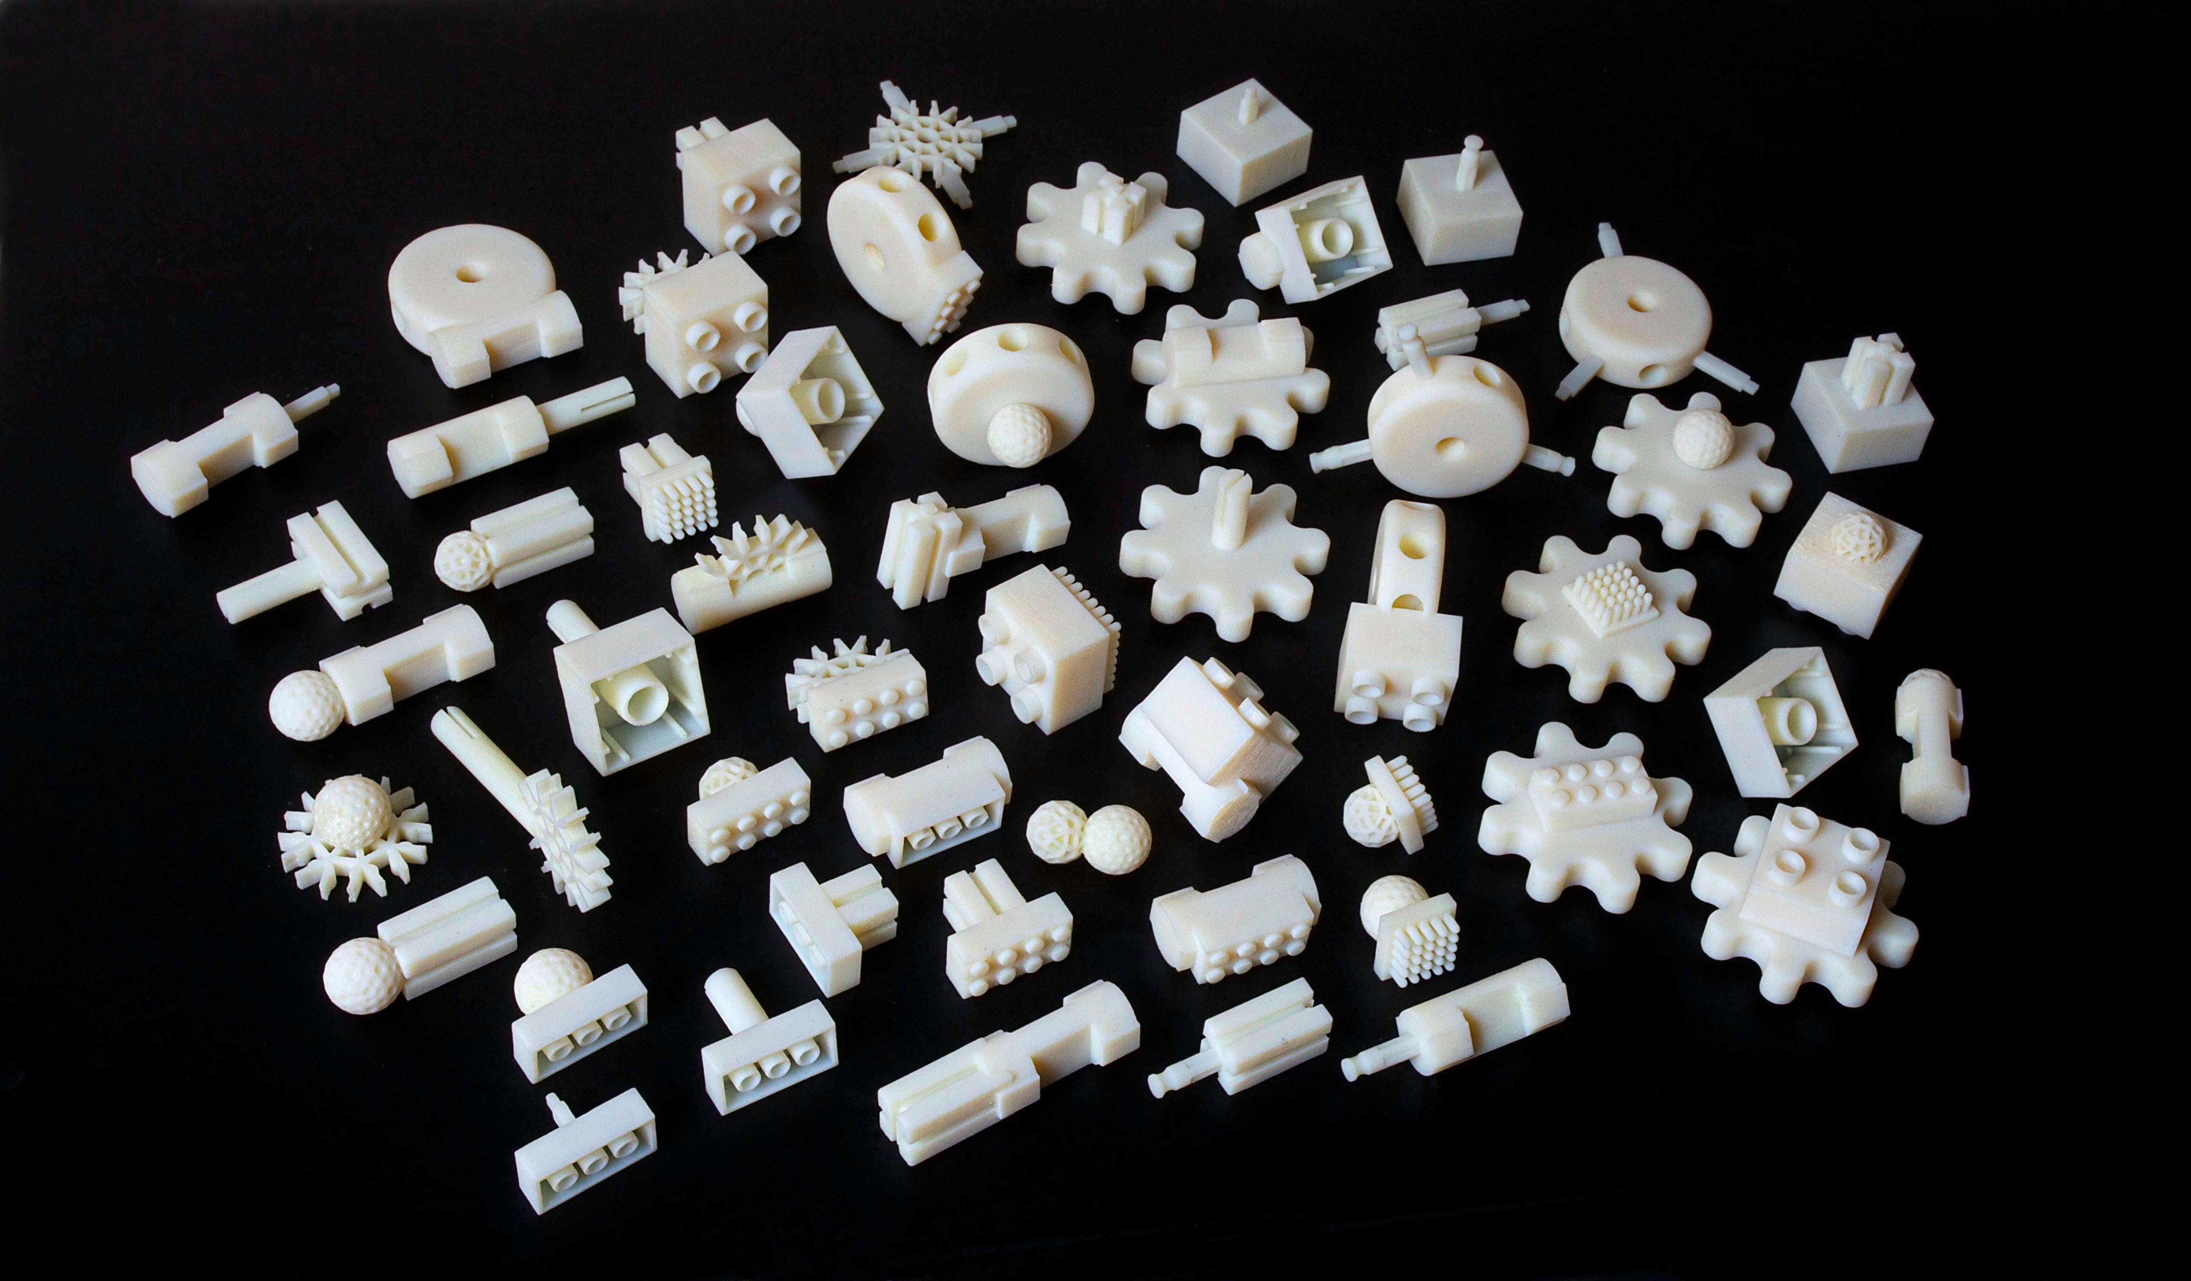
The Free Universal Construction Kit
Notes:
So– What explains the popularity of 3D printing?
Perhaps its that it has revolutionized our ability to interact with the world of things.
It’s changed the balance of power.
Things used to be created by companies, by industries… far away…. in china.
But with 3D printing *we* can make things.
And we can do really interesting things, like print connectors that let us attach Legos to Tinkertoys and Bristle Blocks and Erector Sets and …. Zoob (whatever Zoob is).
So maybe that’s the really interesting thing about Annotation. Maybe it’s the reason we’ve all shown up here today…. Because annotation lets us break the paradigm of the web as constructed by other people.
My favorite example of which is the Free Universal Construction Kit. Because, you know, you always wanted to be able to connect your legos to your erector
In the same way Maybe annotation represents our ability to connect
http://fffff.at/free-universal-construction-kit/
The Free Universal Construction Kit

Slide 19
Now
Notes:
How do we link on the net now? Once and to the top.

Slide 20
Coming Soon
Document “A”
Blog “B”
Notes:
But with an annotation, our blogger can now link within the document instead. And the annotation can serve as a kind of footnote. Because we’re able to link to specific targets, we’re able to connect ideas for the first time.

Slide 21
Document “A”
Blog “B”
Notes:
Instead of just linking once, we can begin to link more richly…

Slide 22
Document “A”
Blog “B”
Notes:
connecting multiple concepts and ideas.

Slide 23
Blog “B”
17m 32s
Notes:
It can be anything. Any kind of media, movies, pdfs, pictures, even data. As long as it has an address or a signature that we can point to or reference.

Slide 24
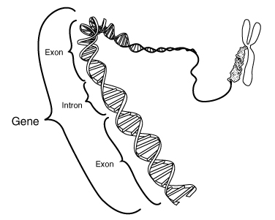
Blog “B”
Notes:
It can be anything. Any kind of media, movies, pdfs, pictures, even data. As long as it has an address or a signature that we can point to or reference.
http://itee.uq.edu.au/~eresearch/annocryst-pymol.php

Slide 25
Selecting for quality
Signal
Meta-moderation
VOLUME
Voice
Noise floor
Obvious trolls
Identity
Spam
SQUELCH
Noise
Notes:
All we’re trying to do is enable conversations… but in order to do that at scale on the Internet, we need a squelch knob.
For those of you who are ham radio operators, you may be familiar with the squelch knob. It lets you set a noise floor, a signal floor, below which you hear nothing. Pure silence. And above which you hear the transmission.
For us, spam and what are affectionately known as obvious trolls– those who have no interest in participating constructively in a conversation– fall below that noise threshold. We will use primarily identity based techniques like two-factor authentication to provide a squelch knob function there. Above that is where helpful conversation is taking place. There we’ll use meta-moderation techniques to expand headroom in the signal of quality conversation.
I’ll talk a little more about how we implement that later.

Slide 26
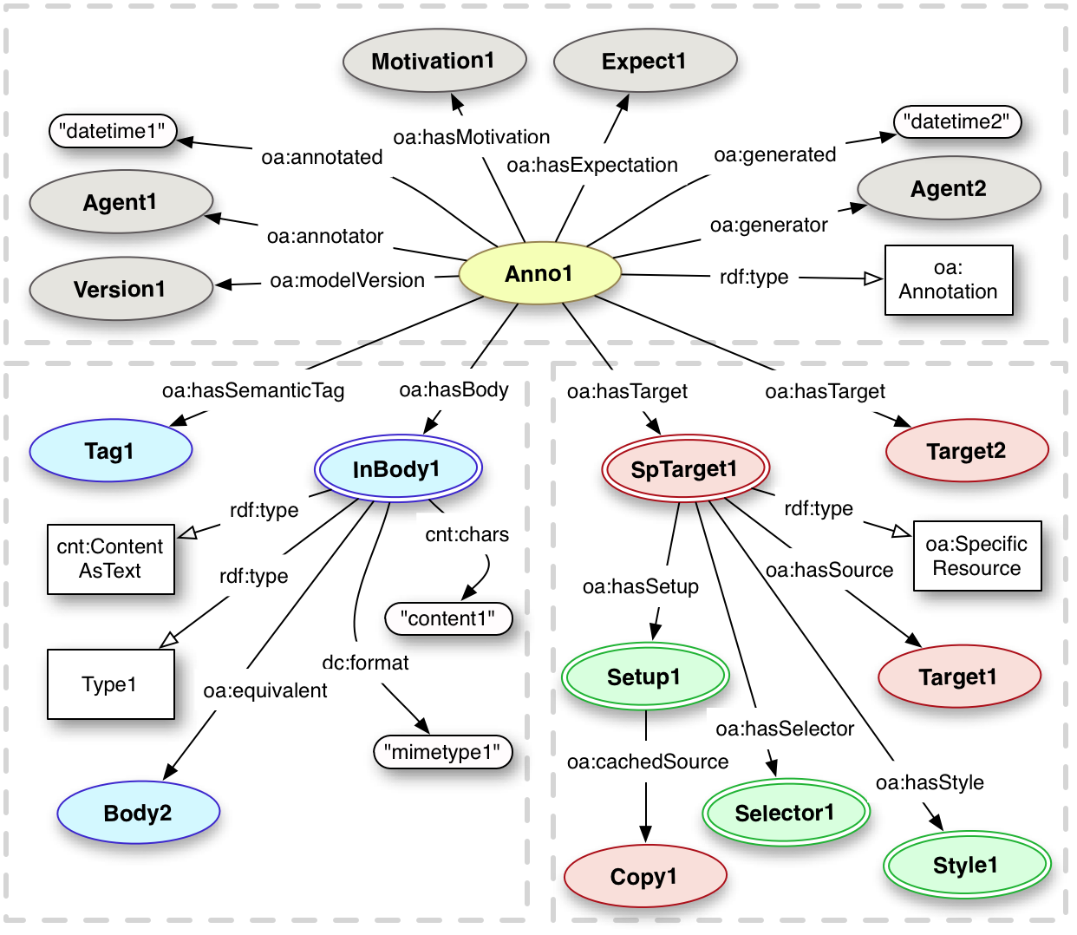
w3.org/community/openannotation/

Slide 27
The annotator stack
front end (h., et al)
annotator
browser
fuzzy anchoring, etc
server
annotator-store
reputation mgmt, etc

Slide 28
The future of open annotation
github.com/hypothesis/h
github.com/okfn/annotator
github.com/okfn/annotator-store
github.com/openannotation

Slide 29
Projects/orgs using annotator’s API
Annotator
Hypothes.is
Finals Club
Annotation Studio (MIT)
Max Planck Institute
UMiss school of Pharmacy
University of Queensland
In consideration:
edX (MIT / Harvard / Stanford online educ.)
Financial Times (ft.com)
PLOS
PeerJ
eLife
BerkeleyX data reproducibility project
Many others…

Slide 30
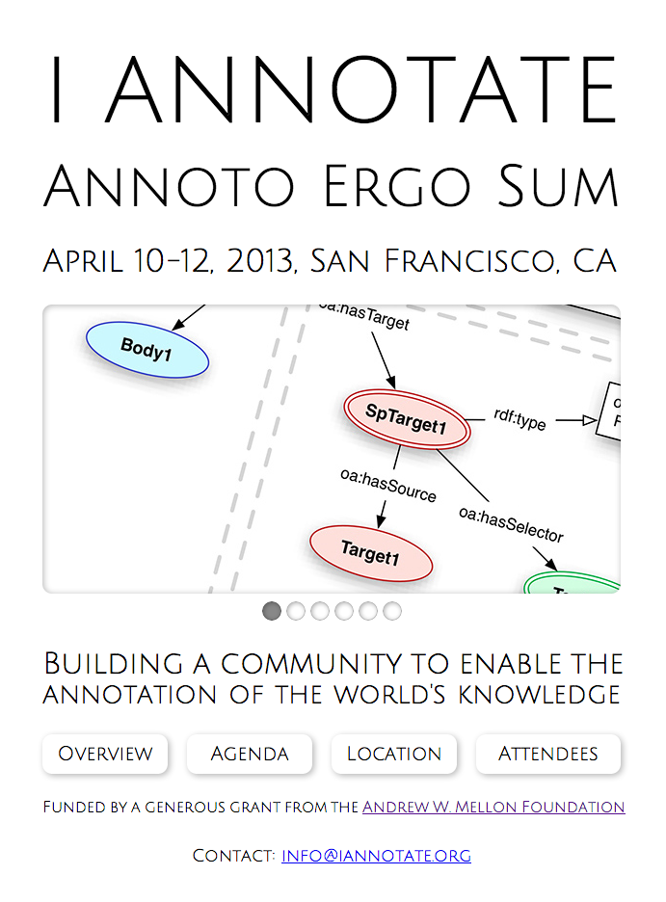

Slide 31
Solving for …
High volume
Personal > group > global contexts
Minor & major doc changes
Cross-format content (HTML & PDFs)
Combining anchored & unanchored
Extension vs embedded
Using the community to moderate the conversation
The cold start
Notes:
Demo

Slide 32
DEMO

Slide 33
Archival permanence
Secured understanding with:
Internet Archive
301works.org domain assumption
Backup of all public annotations
Versioning/memento of resources at every annotation
Other potential trusted repositories
Hathi Trust (academic audience)
Common Crawl (for computing against our corpus)

Slide 34
Five strategies for the next 12 months
Build what end users want, get traction.
Engage with publishers that might embed.
Understand the specific needs of communities of practice.
Develop code and APIs that are reusable and accessible at many layers for different purposes. Nurture the annotation ecosystem.
Understand what it takes to move to the browser.

Slide 35
Market segments
End users
Open web environment
Community/Domain
Verticals: science, humanities, journalism, open government, etc.
Horizontals: students, researchers, publishers, citizens, employees, etc.
Publisher engagement (those who might embed)
Individual organizations or groups
Commercial/Government opportunities
Firms or sectors that are knowledge intensive

Slide 36
Publishing cases
Publishing cases diverge between pre-pub and post-publication scenarios.
Authorship – Annotation is perfect for the collaborative process of writing & revision control between multiple authors.
Pre-pub - peer review easiest at new journals. Same infrastructure to deliver post-publication support.
Pre-print - commentary can function as informal peer review; a gateway to formal consideration.
Post-pub - peer review / commentary.

Slide 37
5 year roadmap
now
Annotation / Anchoring / UI
Reputation model / Peer-review
Cold start
Scale
Sustainability
2012
2013
2014
2015
2016
Notes:
Create second identical slide for What will it cost and delete both growth timelines

Slide 38
Fundraising targets
FY 2012 (till June 2012) - $240k / done
FY 2013 (till June 2013) - $800k / done
FY 2014 (till June 2014) - $2M / 30% of target
FY 2015 (till June 2014) - $5M
FY 2016-7 target for sustainability

Slide 39
Sustainable Revenues
Real time access to the global firehose
Enterprise edition
Custom development
Comment widget replacement
Analytics & Research services
And of course…
Direct member contributions (ala Wikipedia)

Slide 40
Contributors
Board of Directors
Peter Brantley
Kristof Csillag
Luca de Alfaro
Jake Hartnell
Randall Leeds
Susan Nesbitt
Michael Shavlovski
Nick Stenning
Ed Summers
Jehan Tremback
Gergely Újvári
Dan Whaley
John Perry Barlow – Founder, EFF
Gerry Percy – Founder, Odwalla
… And many more
Notes:
I’d like to just acknowledge one person above all others… Our lead developer, Randall Leeds, without whose excellence and passion none of this would have been possible.

Slide 42
Backup…

Slide 43
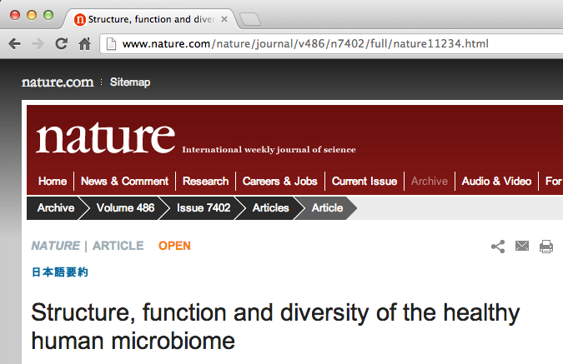
It should be where we are.
Notes:
****** DEMO *******

Slide 44
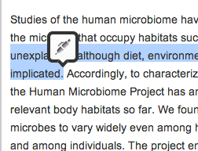
Select some text.

Slide 45
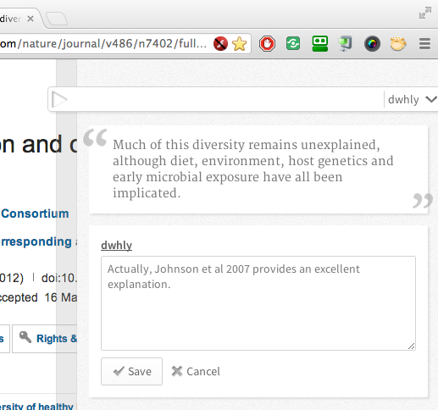
Contribute our thinking.

Slide 46
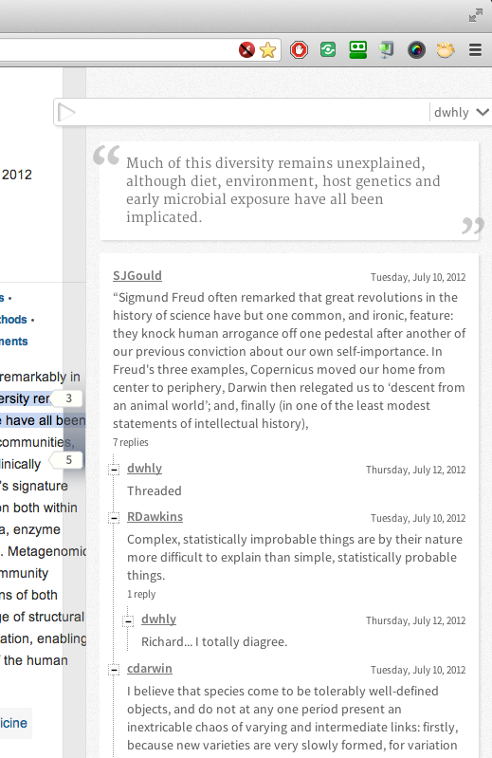
Have a discussion.

Slide 47
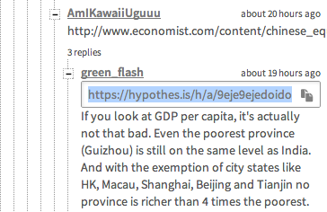
Link to it.

Slide 48
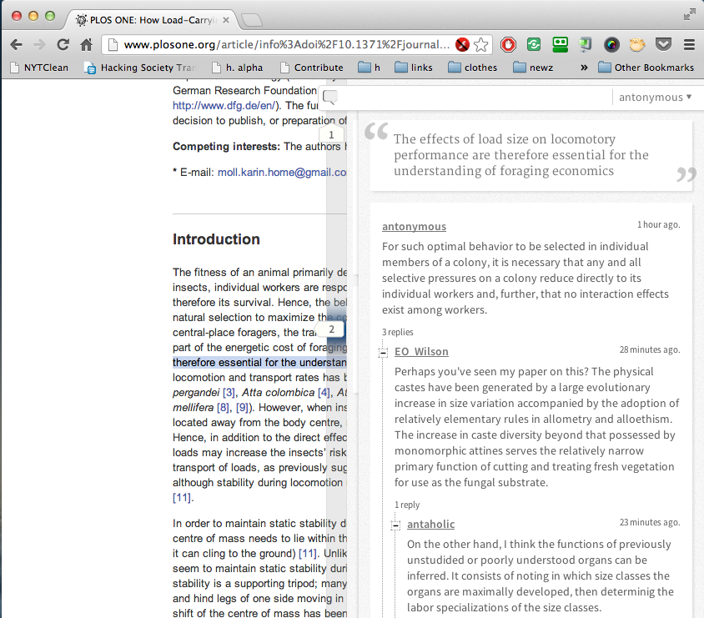
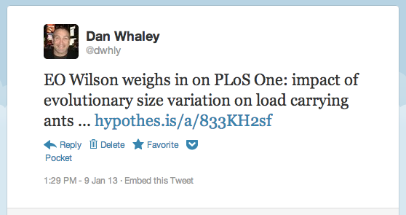
Share it.

Slide 49
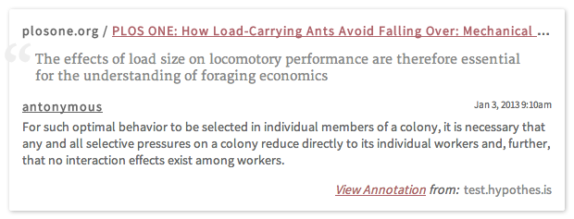
Embed it.

Slide 50
Survive (minor) changes.
The quick brown fox juxps over the lazy dog.

Slide 51
Survive (minor) changes.
The quick brown fox juxps over the lazy dog.

Slide 52
Survive (minor) changes.
The quick brown fox jumps over the lazy dog.

Slide 53
Survive (minor) changes.
While the mice are away the cat will play.
The quick brown fox jumps over the lazy dog.
Jack and Jill ran up the hill to fetch a pail of water.
prefix
selection
postfix

Slide 54
Survive (minor) changes.
While the mice are away the cat will play.
The quick brown fox jumps over the lazy dog.
Jack and Jill ran up the hill to fetch a pail of water.
prefix
selection
postfix
https://github.com/hypothesis/h/wiki/fuzzy-anchoring

Slide 55
Survive larger edits

Slide 56
Survive larger edits

Slide 57
Annotate anywhere, view everywhere
URL
URL / doi / hash
HTML
PDF

